Slide 1
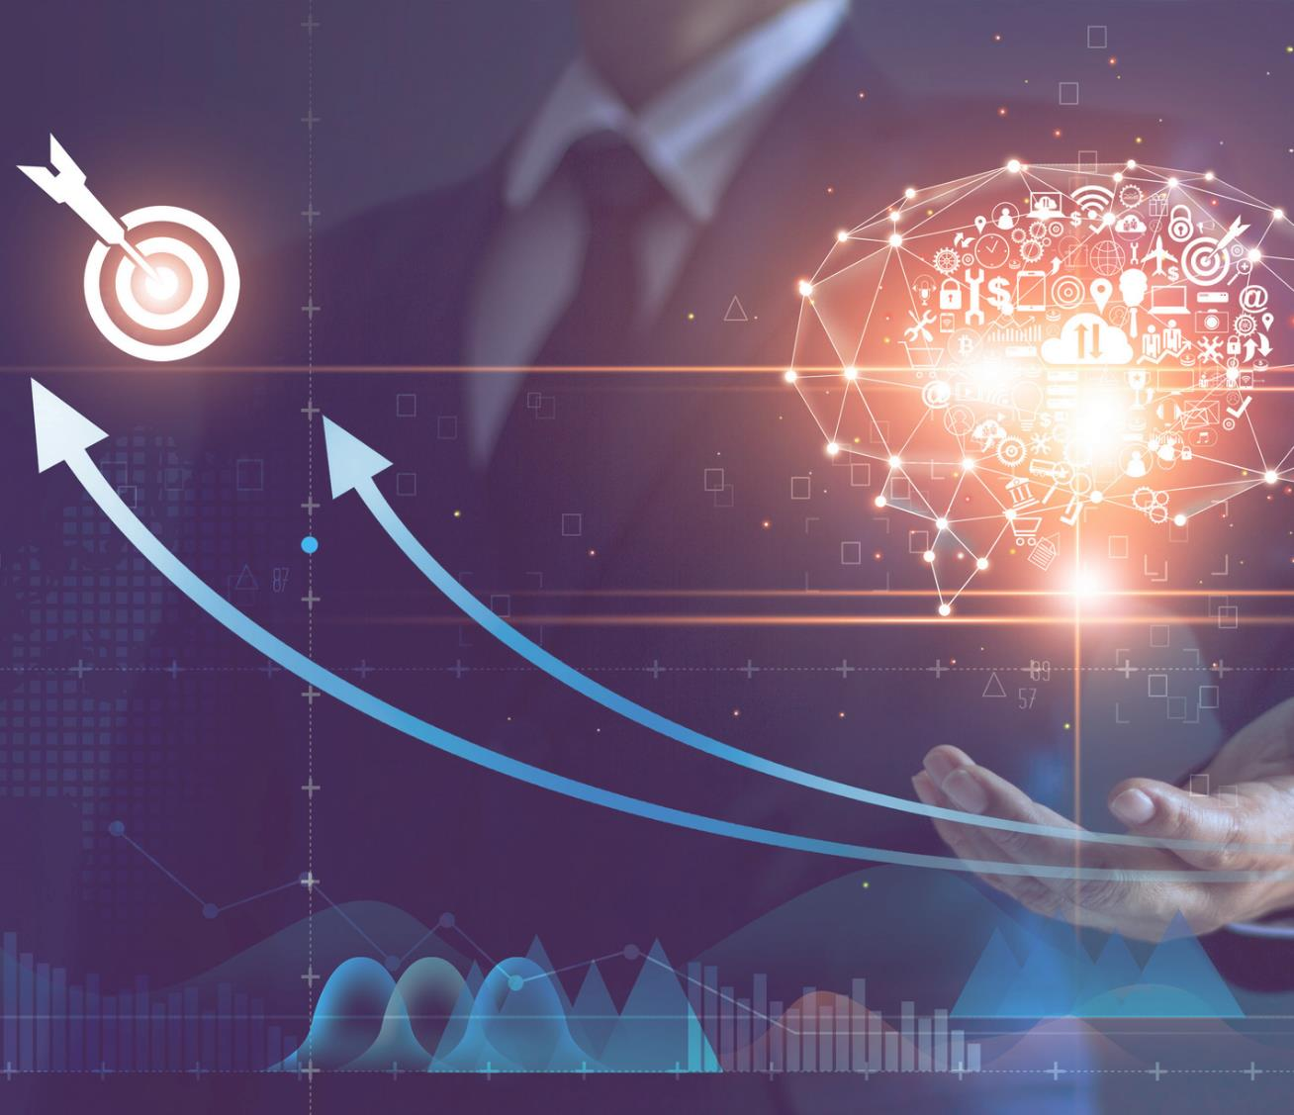



Splunk Training Session - HSCC

Slide 2
Introduction
Splunk is a software used to search and analyze machine data.
This machine data can come from web applications, sensors, devices or any data created by user.
It serves the needs of IT infrastructure by analyzing the logs generated in various processes but it can also analyze any structured or semi-structured data with proper data modelling.
It has built-in features to recognize the data types, field separators and optimize the search processes.
It also provides data visualization on the search results.

Slide 3
Splunk Features
Data Ingestion - JSON, XML, unstructured machine data like web and application logs
Data Indexing – fast search and query
Data Searching – features, patterns, trends
Alerts – Mail, RSS feed
Dashboards – Charts, Reports and Pivot
Data Model – Saved data sets

Slide 4
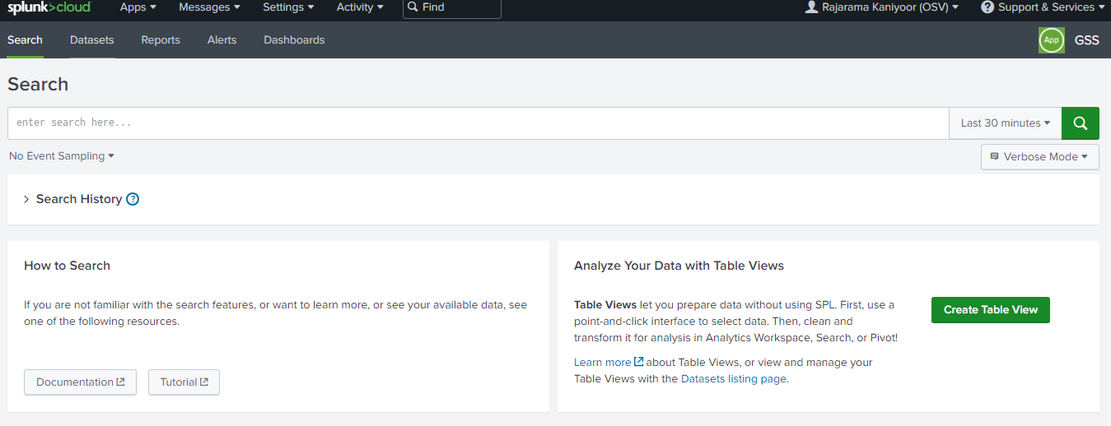
Search and Reporting

Slide 5
Basic searching
Keywords
Phrases -> " "
Field -> Key=value pair
Wild card -> *
Boolean -> AND, OR, NOT
| -> pipe the streaming
Splunk keywords -> _time

Slide 6
Splunk Commands
- chart/timechart
- rename
- sort
- stats
- eval
- dedup
- table

Slide 7
Search Examples
For UDS Adaptor server type below filter and select timestamp
https://fedexservices.splunkcloud.com/en-US/app/launcher/home
https://fedexservices.splunkcloud.com/en-US/app/fedex_app_gss_909263/search
index=*clw* cf_org_name=3538276 cf_app_name=“udsAdaptor-phuwv-collector” sourcetype=“cf:logmessage”
Append below criteria to the above query
- table _time host source
- eval timestamp=strftime(_time, "%d, %B, %H:%M %p")
- rename host as IP source as Source
- sort _time

Slide 8
Intermediate searching
Splunk defines some general functions using Pipe operator
| top field
| rare field
| stat <function (field)> BY field/s - count, avg, max, sum, value, list etc.
| chart or timechart
Examples
- top host -> top limit=5 totCount by host
- rare host
- stats -> stats count(index) by host
- chart -> chart count(index) as totCount by host

Slide 9
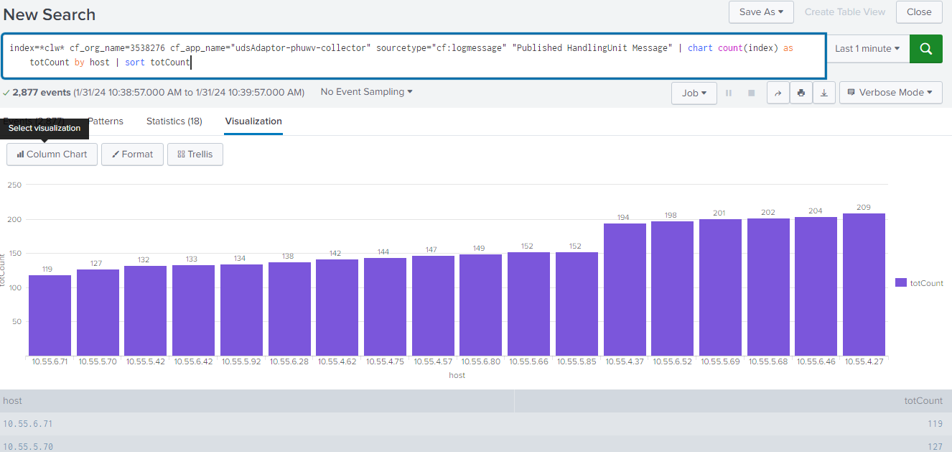
Report and Chart

Slide 10
About Mphasis
Mphasis (BSE: 526299; NSE: MPHASIS) applies next-generation technology to help enterprises transform businesses globally. Customer centricity is foundational to Mphasis and is reflected in the Mphasis’ Front2Back™ Transformation approach. Front2Back™ uses the exponential power of cloud and cognitive to provide hyper-personalized (C=X2C² _{TM}=1) digital experience to clients and their end customers. Mphasis’ Service Transformation approach helps ‘shrink the core’ through the application of digital technologies across legacy environments within an enterprise, enabling businesses to stay ahead in a changing world. Mphasis’ core reference architectures and tools, speed and innovation with domain expertise and specialization are key to building strong relationships with marquee clients. Click here to know

